Slide 1
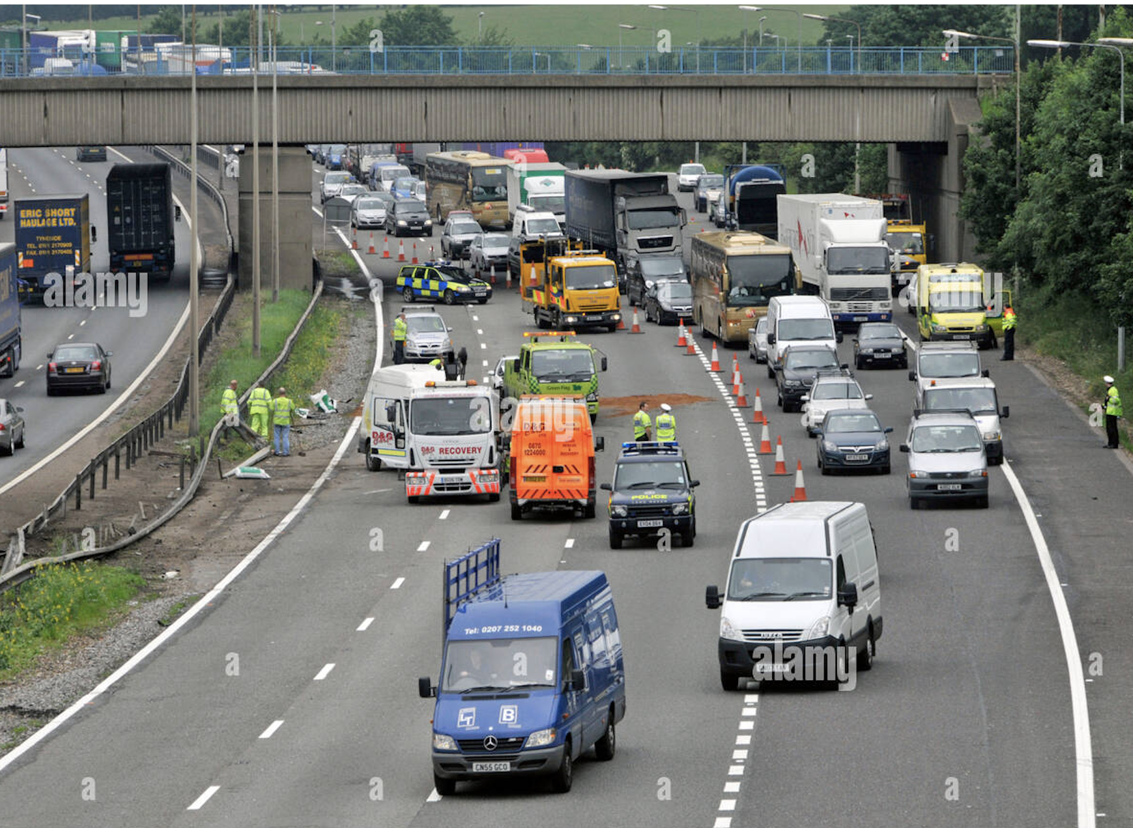

ACCIDENTS IN UK
Keerthi Chittimalla

Slide 2

CONTENT
Overview
Steps performed for Analysis
Data collection from source
Data preprocessing
Data Visualization
Data Modelling
Conclusion

Slide 3
Overview
Road accidents is one of the main issues in the world from past many years. There are many accidents happening all over the world and are leading to death of the person or injury.
By using the Open Road Safety Data for the 2020 dataset, which is available in the government website, I am performing the data analysis, plotting various visualizations and performing the machine learning algorithms.
My idea of the project is to predict the severity of accidents using the machine learning model and see which model gives the better results in predicting the severity of accidents.

Slide 4
Steps performed for Analysis
Data Collection from source
1
Data Pre-processing
2
Data Visualization
3
Data Modeling
4
Evaluation of the results
5

Slide 5
Data collection from Source
Data is regarding the road accidents occurring in UK. Here I am collecting the data from this site https://www.data.gov.uk/dataset/cb7ae6f0-4be6-4935-9277-47e5ce24a11f/road- safety-data
Used three CSV files which was published on 16 October 2021
Road Safety Data – Casualties 2020
Road Safety Data – Vehicles 2020
Road Safety Data – Accidents 2020
Road Safety Open Dataset “Data Guide.xlsx” is a supporting guide file which has details on Codes and Formats present in the csv files

Slide 6
Data Frame: Data frame is 2-dimensional data structure like a 2-dimensional array, or a table with rows and columns. Null values: It is also called as None. None is a special object that represents the absence of a value. A function that doesn't return a value automatically returns None. Data type: Data types are the classification or categorization of data items. It represents the kind of value that tells what operations can be performed on a particular data. There are different data types. Categorical or Numerical: Categorical data refers to a data type that can be stored and identified based on the names or labels given to them. Numerical data refers to the data that is in the form of numbers, and nit in any language or descriptive form. Data Visualization: It is the graphical representation of information and data. It is an accessible way to see and understand the data.

Slide 7

Data Preprocessing
As I have three CSV files, I have merged all the three into a single data frame with a common column.
After merging, the data frame has 177024 rows and 79 columns.
Removed the Null values.
Removed few Unnecessary Columns.
Converted the Date column to to Datetime data type which can be used for the Visualizations.
Converted few columns into Categorical Values.

Slide 8
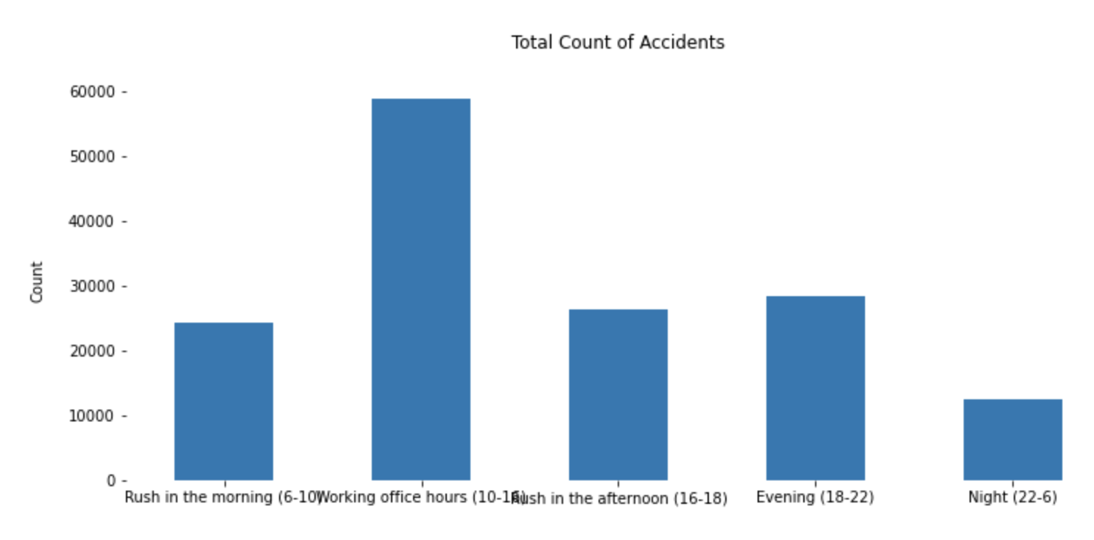
Data Visualization
Around What time of the Day do Accidents occur the most?
From the bar graph we see that most of the accidents are in the morning time that is from 10-16 which is working office hours time and the count is almost 60000
Least is during the night from 22-6, the count is nearly 15000.
Here I have used the 24hour clock.

Slide 9
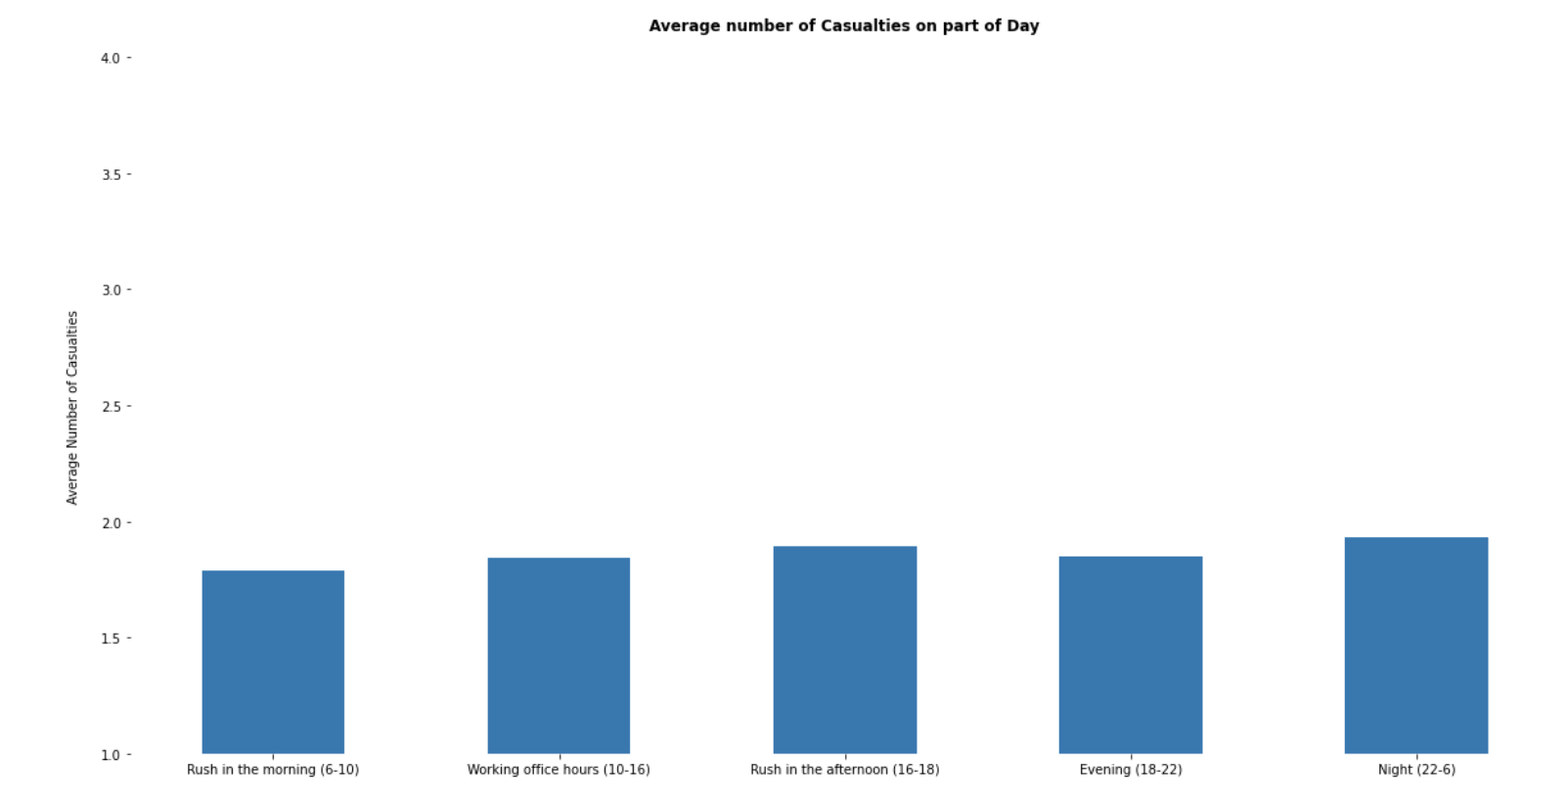
Average number of Casualties based on part of a day
From the bar graph I see that there are a greater number of casualties in the nighttime that is from 22-6.
Least count is rush in the morning 6-10
The greater number of casualties during night may be due to bad lighting is one of the reason.

Slide 10
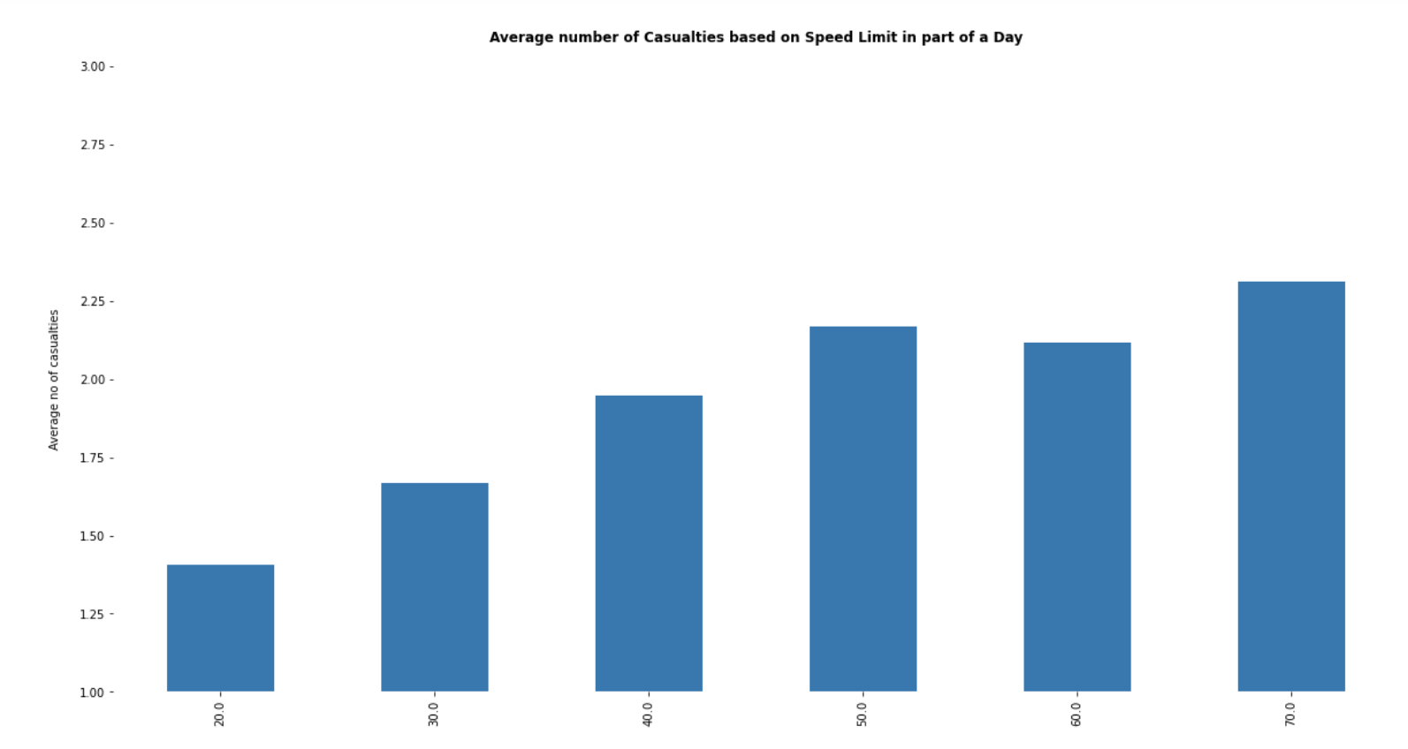
Average number of Casualties based on Speed limit in part of a day
From the graph we see that there are a greater number of casualties with the speed limit of 70.0mph
Least number of casualties with a speed limit of 20.0mph

Slide 11
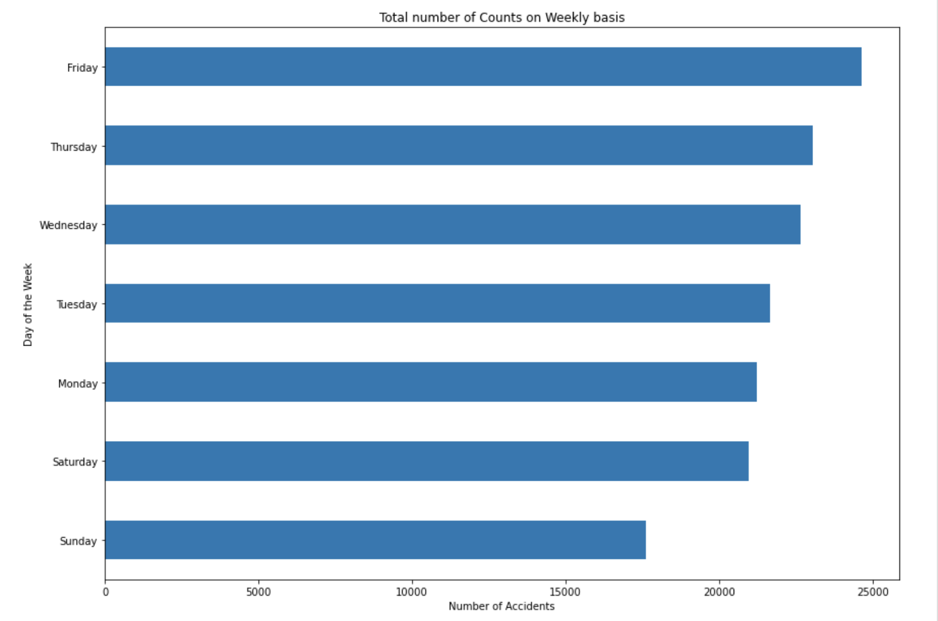
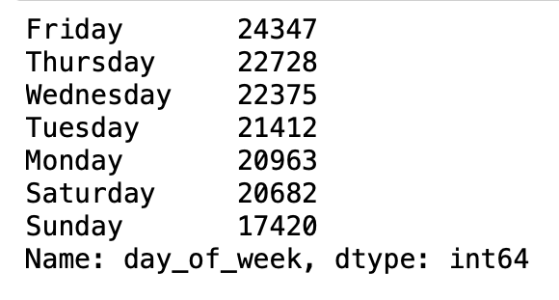
Total count of Accidents on Weekly Basis
From the graph and the count, we can see that there are a greater number of accidents during Friday the reason maybe due to the weekend and the least is on Sunday.

Slide 12
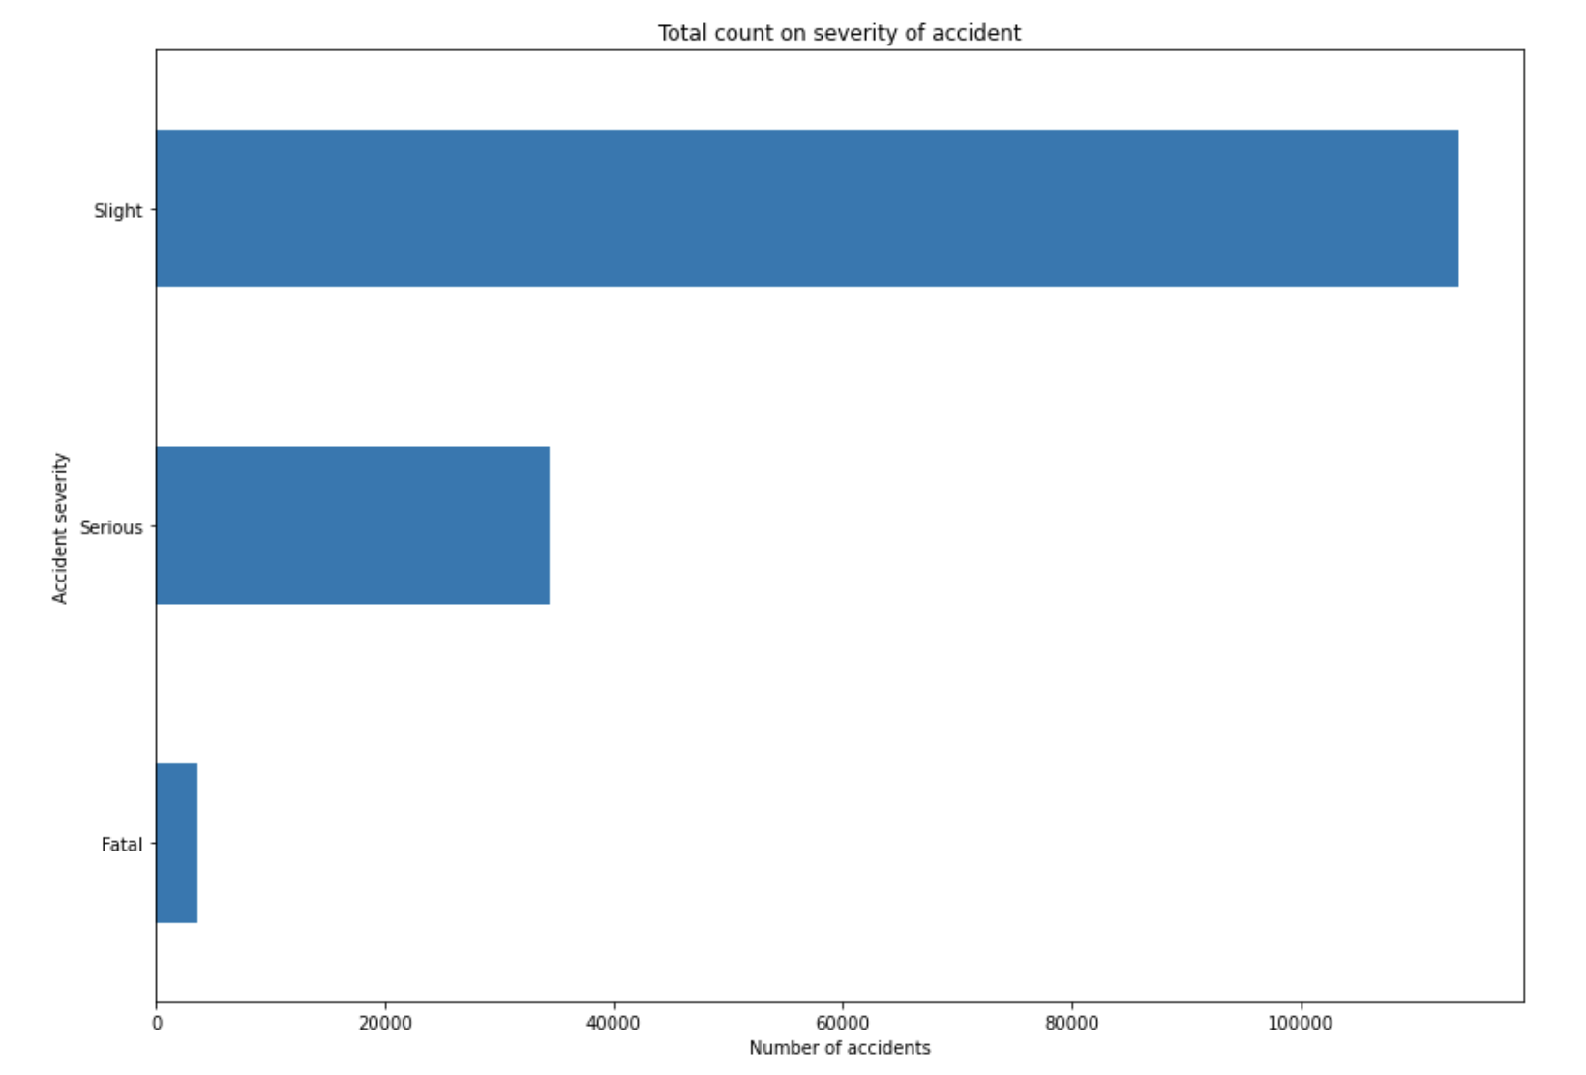
Total count on Severity of accident
From the graph we can see that slight has been the highest count in the severity of accidents whereas the least is Fatal.

Slide 13
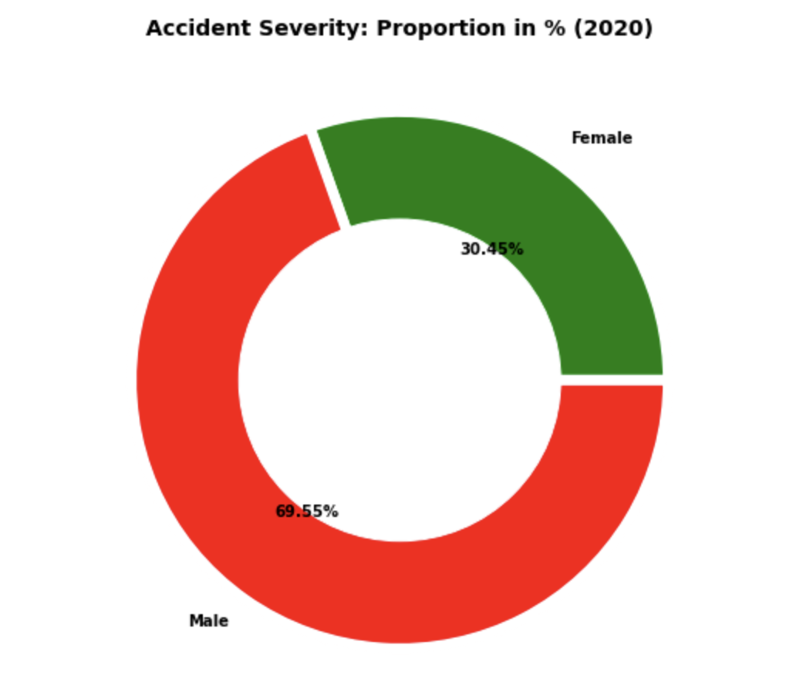
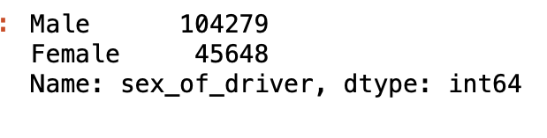
Accidents based on Gender
From the pie chart we can see that male are more involved compared to female in the accident.
Male percentage is 69.55% whereas female count is 30.45%
Male count is 104279 and female count is 45648.

Slide 14
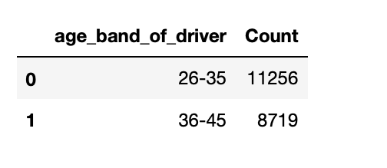
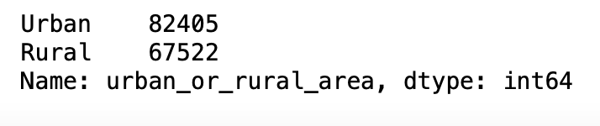
Accidents based on Age group
Accidents in Urban or Rural areas
The age group between 26-35 are more involved in the accidents and the count is 11256.
From the above count we see that most of the accidents are in the urban area compared to rural area.

Slide 15
Machine learning Algorithms
Gaussian Naïve Bayes
KNN Model
Decision Tree
Random Forest Classifier

Slide 16
Accuracy: Accuracy is defined as the the total correctly classified example divided by the total number of classified examples. Recall: Recall is calculated as the number of true positives divided by total number of true positives and false negatives. Precision: Precision is defined as the actual correct prediction divided by total prediction made by model. F1 Score: F1 score is a weighted average of precision and recall. Confusion Matrix: Confusion Matrix is a table that summarizes how successful the classification model is at predicting examples belonging to various classes. One axis of the confusion matrix is the label that the model predicted, and the other axis is called actual label.

Slide 17
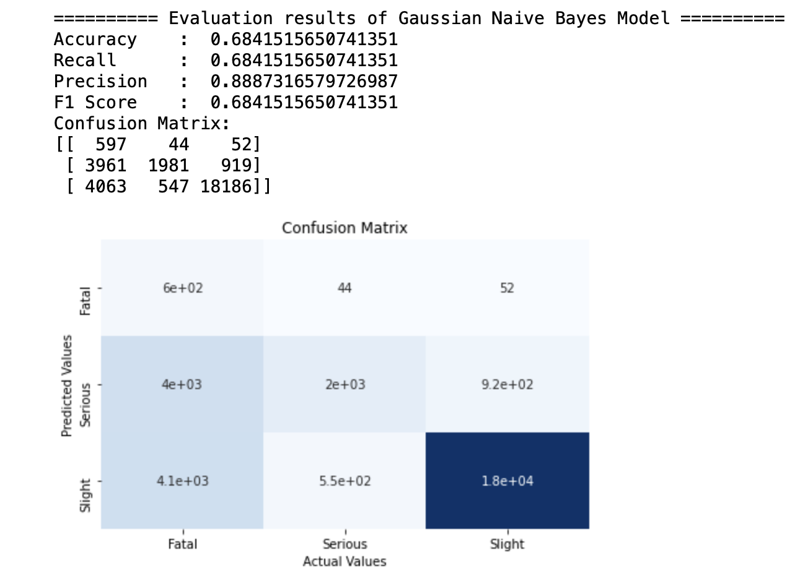
Gaussian Naïve Bayes
It is a very simple classification that can make strong assumptions on every input variable independence.
The Gaussian Naive Bayes has given the accuracy of 68% which is not so great, and the Recall is 68%, Precision is 88%, F1 score is 68%.
And coming to the confusion matrix we see that it has predicted Slight more accurately, but the prediction is less for the others. so, I think this is not good for the analysis.

Slide 18
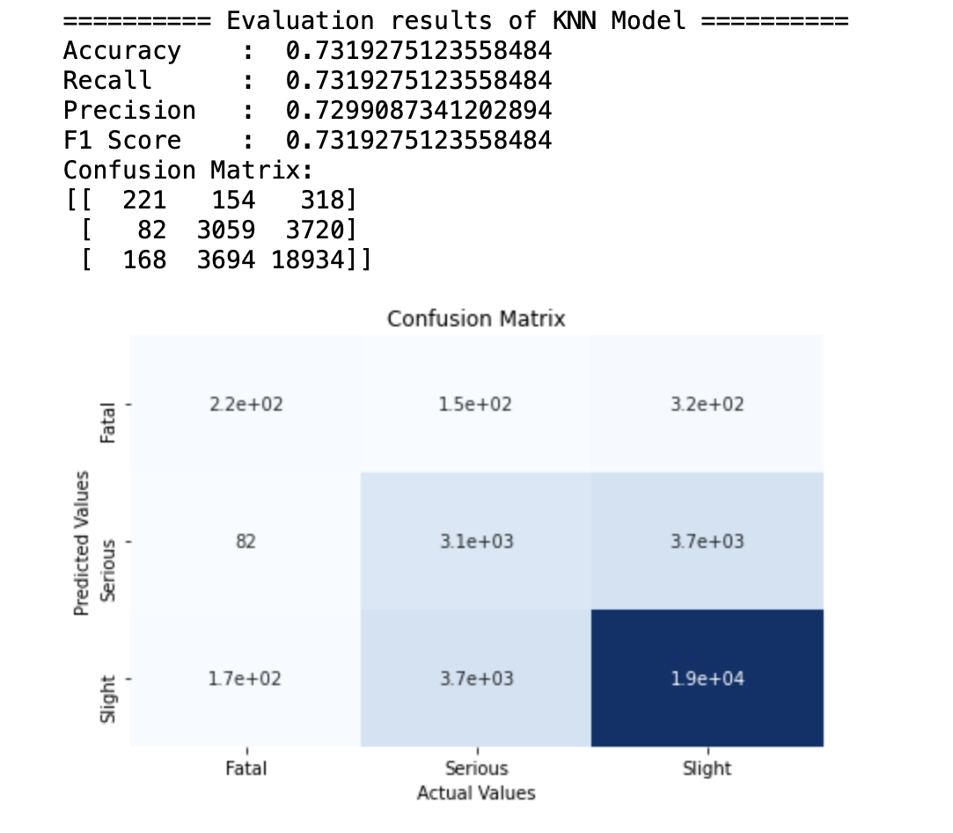
KNN Model
K-Nearest Neighbors Algorithm is a powerful algorithm to make the predictions. Here we are using KNN algorithm by taking 'n_neighbors' with 4.
The KNN has given the accuracy of 73% which is better than naive bayes, and the Recall, Precision, F1 score is also 73%.
And coming the the confusion matrix I see that true positives are also improved but let's try some other models.

Slide 19
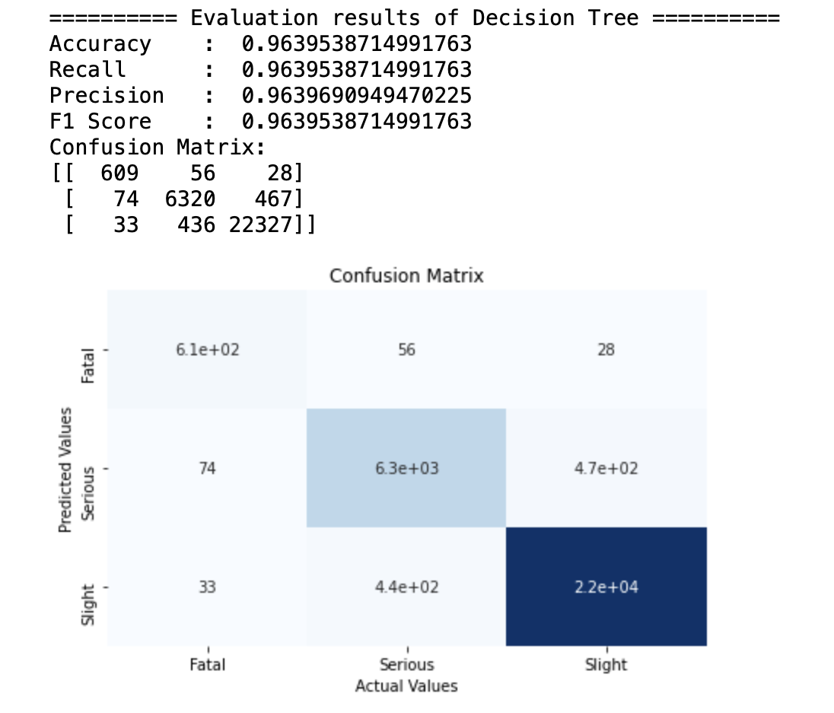
Decision Tree
A Decision tree is a support tool with a tree-like structure that models probable outcomes, cost of resources, utilities, and possible consequences.
The Decision tree has given the accuracy of 96% which is so good, and the Recall, Precision, F1 score is also 96.3%.
And coming to the confusion matrix I see that it has predicted more accurately compared to the other models.

Slide 20
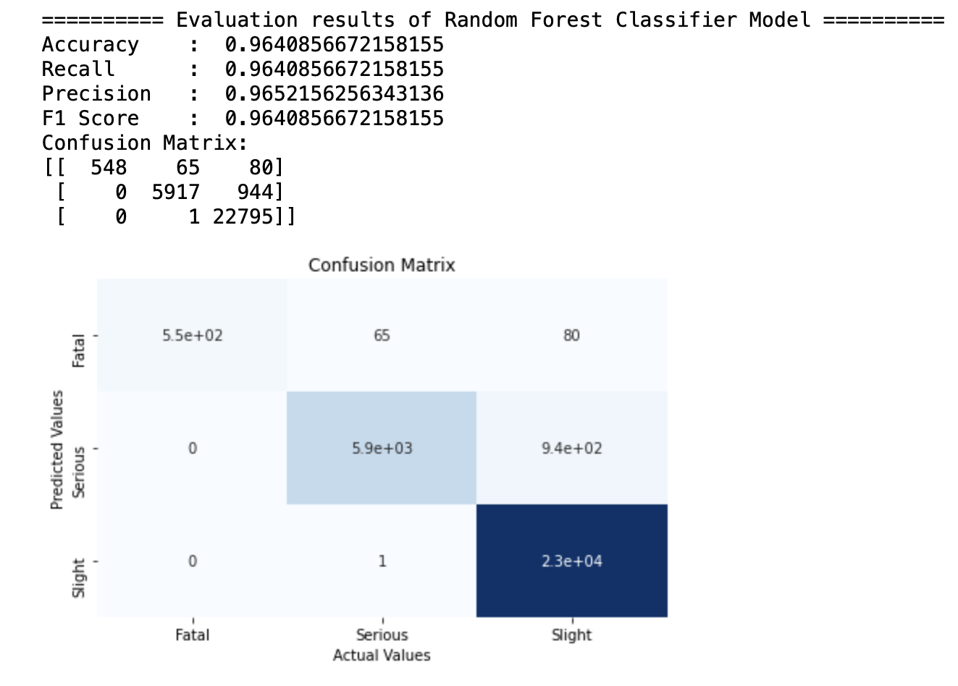
Random Forest Classifier
Random forest is a supervised learning algorithm, mostly used because of its simplicity and diversity (used for both classification and regression).
The Random forest classifier has given the accuracy of 96.4% which is same as decision tree, and the Recall, Precision, F1 score is also 96.4%.
And coming the the confusion matrix I see that it has predicted more accurately compared to the other models.

Slide 21
Conclusion
First started with cleaning the data and data pre-processing.
Next performed some visualizations, which shows that most of the accidents are during the working hours from 10-16 and I see that there are a greater number of casualties in the nighttime that is from 22-6
There are a greater number of accidents during Friday compared to other days may be due to the weekend, whereas coming to severity of accidents there were more Slight accidents compared to Serious and Fatal.
Coming to the gender we can see that male are more involved compared to female in the accident. Male percentage is 69.55% whereas female count is 30.45% and the age between 26-35 are more involved in the accidents compared to 36-45.
Random forest classifier has been given the highest accuracy and confusion matrix in predicting the severity of accidents.

Slide 22
Conclusion As my idea of the project is to predict the severity of accidents using the machine learning models which I have mentioned , the analysis which I have got by the end of the project can be helpful for either police department or government of UK in taking necessary steps and to reduce the number of accidents from occurring.

Slide 23
GitHub Link https://github.com/keerthichittimalla/Accidents-in-UK.git

Slide 24
References
Sarang Narkhede. (May 9, 2018). Understanding Confusion Matrix
https://towardsdatascience.com/understanding-confusion-matrix-a9ad42dcfd62
Himanshu Singh. (Jun 7, 2018). Supervised Learning Methods using Python
https://medium.com/@himanshuit3036/supervised-learning-methods-using-python-bb85b8c4e0b7
Difference between Random Forests and Decision tree
https://stats.stackexchange.com/questions/285834/difference-between-random-forests-and-decision-tree
Onel Harrison. (Sep 10, 2018). Machine Learning Basics with the K-Nearest Neighbors Algorithm
https://towardsdatascience.com/machine-learning-basics-with-the-k-nearest-neighbors-algorithm-6a6e71d01761

Slide 25

Thank You

